Slide 1
Group Project - Milestone 1
Project Members:
Tan Yong Jie (2400994)
Amos Teo (2400571)
Lwin Moe Aung (2400594)
Leon Chia (2401047)
Beckham (2400867)
James (2403139)
Aloysius (2401686)
Kim (2403290)

Slide 2
Game flow
Start
Pre-Game
Game
Post-game
End

Slide 3
Pre-Game
“#include” section
#include <stdio.h>
#include <unistd.h>
#include <string.h>
#include <ctype.h>
#include "SatComRelay.h"
Declaring of variables section
char filename[15],file_directory[20];
bool scr_name_bl, random_start_pos_bl;
int mission;

Slide 4
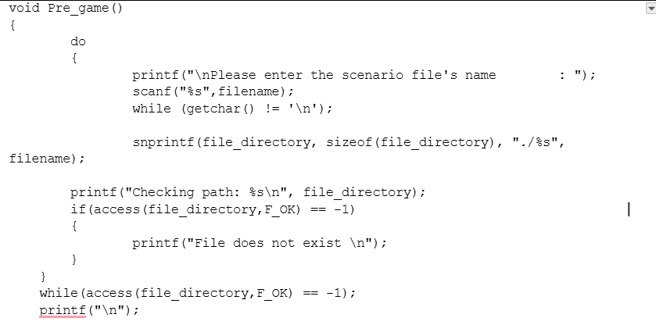
Pre-Game

Slide 5
- Summarize key points from each section of your report into *.ppt powerpoint slides, and ... present!
- Be prepared to answer any impromptu question(s) from tutor, which may be directed at specific individuals

